Slide 1

Power BI
Best Practices
Created: 13/08/2022

Slide 2
Performance Methodology
Talent Pool:
The people who create the team alignment, and team culture
Data Maturity Assessment.
Data Strategy based on DCAM
Data
Process
People
Mindset
How do we execute the processes
How we implement and asses the data
value chain
Shrikesh Pattni

Slide 3
Raw Data Structures
How is the current data formatted, tabular or cross
Do we need to consider slowly changing dimensions
SQL – do we need to add in a stored procedures so we only import data from a specific period
Azure Synapse – can we use the default serverless architecture and create a Power BI datasets to
What is the thinking of using composite models (azure analysis services) IF there is a need
How often is the data getting refreshed, do we have dimensions we need to create.
Don’t overly complicate this section, keep it simple and do some data exploratory on what you have
Raw Data Structures
Shrikesh Pattni

Slide 4
Pre Development Setup
Auto date/time: Disable
Auto detect relationships: Disable
Use cross filtering instead of cross highlighting: Enable
Separate dataset from report
Pre Development Setup
Raw Data Structures
Shrikesh Pattni

Slide 5
Data Source & Power Query
Remove Unnecessary Columns (not hide) from your data. If you are not reporting on a specific field, remove the column at source
Try and not use to “GROUP BY” inside Power Query. This can drastically slow down the refresh
Re-Engineer the columns that have long string of ID, have short strings of ID. So only import short strings of ID.
If you have multiple queries that are static (don’t need to be refresh) make sure you turn them off inside Power Query.
Do as much data transformations at source (SQL) before loading into Power Query, this enables Query Folding
If you have big data stored inside Azure Databricks, make sure you have loaded into a Database before loading into Power BI
Use dedicated [Dates] table and mark as a date table
Have we parameterized the data sources so we don’t get user errors
Source: Use existing report/dataset before developing new
Reference the source query, and duplicate all others queries for indexing
Performance - Data Volume: Reduce as much as possible
Performance - Query Folding: Enable as much as possible
Performance - Data Connectivity Mode: Use Import if possible
Naming/Data Types
Granularity: Strive to source data at consistent granularity
Data Sources & Power Query
Pre Development Setup
Raw Data Structures
Shrikesh Pattni

Slide 6
Data Modelling 1/2
Star Schema Waterfall Layout: Lookup tables above fact tables
Waterfall Layout: Supporting tables at bottom-left (rows)
Use Manage Relationships dialog, use edit relationships dialog
Use 1-to-many relationships/avoid bi-directional relationships
Using Cross Filter or TREATAS within the DAX if bi-directional relations is needed, or M-2-M
Use Active and Inactive Relationships/Use Measure Tables
Rename linking columns (Key)
Column Visibility: hide key, sort
Normalise your data to reduce data duplication inside your tables.
Only fetch the tables which are required.
Avoid relationships on calculated columns and unique identifier columns.
Keep the model as narrow and as lean as possible because Power BI works on columnar indexes, hence longer- tables are preferred.
Try not to always use “Calculated Columns”, use “Calculated Measures” instead as the memory is cache
Create a 1-2-Many Relationship. Avoid Many-To-Many. Use Bridge Tables to avoid Many-To-Many
Avoid breaking down “Dates” related information into Month/Quarter/Year in the same table. Create a Dates Tables if needed.
Import vs Direct Query, always try and use Import Mode as the data is saved in memory
Make sure you have thought about using Aggregation Semantics Models, for any datasets (mainly for big data)
Data Modelling
Data Sources & Power Query
Pre Development Setup
Raw Data Structures
Shrikesh Pattni

Slide 7
Data Modelling 2/2
Import Engine
ii. Allows full DAX capability un-like other storage modes.
iii. Fast connection
iv. Full DAX expressions
v. Power BI fully functional
vi. Full Power Query Transformations
vii. Data Blending (Can combine data from different sources)
Direct Query
i. Large Scale data sources supported. No size limitation
ii. Very limited DAX, difficulty when implementing DevOps
iii. Very limited Power Query functionalities.
iv. Slower Connection (Aren’t cached, Network Latency, depends on the location of database many other factors can make it slower)
Push calculated columns and measures to the source where possible. The closer to the source, the higher the likelihood of performance.
Avoid distinct counts on fields with high cardinality – that is, millions of distinct values.
Make sure you are using the correct Power BI Storage Mode for your mode:
Storage Mode
Highest speed by leveraging locally cached in-memory data that is compressed using column
Data Modelling
Data Sources & Power Query
Pre Development Setup
Raw Data Structures
Shrikesh Pattni

Slide 8
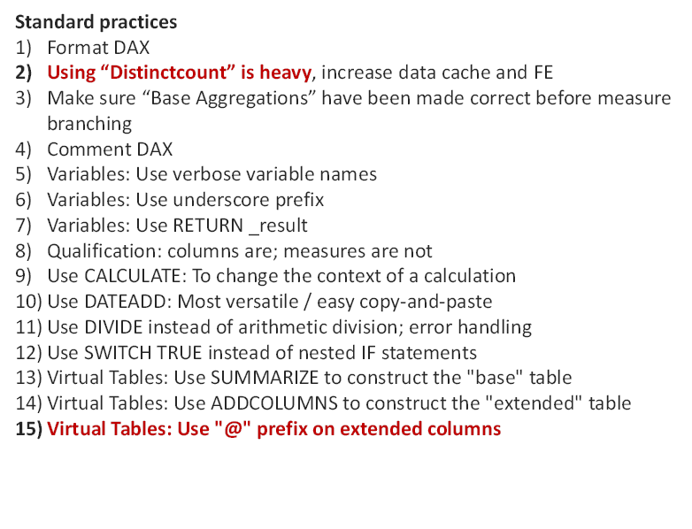
DAX
DAX
Data Modelling
Data Sources & Power Query
Pre Development Setup
Raw Data Structures
Shrikesh Pattni

Slide 9
Visualisation
Use transparent colours
Use table-first development (TFD)
Use Reset Slicers bookmark and button
Use Slicer (don’t overkill!) Selection echo area
Use button On Hover behaviour to add interactivity
Use textboxes with measures to add dynamic narratives
Set the data category for location fields
Use Edit Interactions to modify filter effect on visuals
Use Selection pane to name and order all visuals
Identifiers: add report ID, version, version date, last refresh date
Performance: Minimize number of visuals per page
Performance: Use "dropdown" slicers in lieu of "list" slicers
Performance: Collapse filter pane before saving
It is not a good idea to keep too many visuals on one report page. Always think how creatively you can visualize & organize your information in less number of visuals and keep your report clean and faster.
FORMAT / GENERAL to adjust X/Y/Width/Height to multiples of 10 px
Have we implemented a semantic design JSON formatted templates for all fonts/all visuals/titles
Have we used grids, and user friendly colours
Use Model View to turn off summarization
Keep Selection pane and Bookmarks pane visible at all times
Set format of date columns to dd-mmm-yyyy
Set Matrix column width
Think in grids / align visuals
Visualisation
DAX
Data Modelling
Data Sources & Power Query
Pre Development Setup
Raw Data Structures
Shrikesh Pattni

Slide 10
Vertipaq Engine
Upload the PBIX into DAX studios and script out the PBIX files
Does the data model have any referential integrity violations
Have we set “value encoding” for integers and decimals data types
Has the data mode been analysed based on the Storage Engine context vs Formular Engine Context
Which columns names have the highest cardinality (uniquid ID) and can these columns be optimized
What do the partition numbers show on the table section
Which tables/relationships are causing the highest % overload on CPU
What are the invalid rows within the tables (Referential Integrity Violations)
Analyze the % DB size in relationships and columns sizes
Can we optimize the data types, i.e. Whole numbers we use vs long decimals or even keys
Transaction ID = 1000-100-01-101, can we turn this to 101
Transaction ID = 1000-100-01-102, can we turn this to 102
Transaction ID = 1000-100-01-103, can we turn this to 103
Transaction ID = 1000-100-01-104, can we turn this to 104
Vertipaq Engine
Visualisation
DAX
Data Modelling
Data Sources & Power Query
Pre Development Setup
Raw Data Structures
Shrikesh Pattni

Slide 11
BPA Rules
Preload the BPA rules either from GITHUB URL, or copy C# code into tabular editor advanced scripting
Analyze how many issues the model has, and how many of these issues can be fixed
Create a pipeline (Azure Data Factory) and analyze the BPA rules against all Power BI Reports on tenant
BPA Rules
Vertipaq Engine
Visualisation
DAX
Data Modelling
Data Sources & Power Query
Pre Development Setup
Raw Data Structures
Shrikesh Pattni

Slide 12
VPAX/ Dynamic Management View
Have we centralised the VPAX file and is this shared, and maintained
Import the DMV’s (data on the data) so we understand overall governance
Have we checked the levels of “Referential Integrity Violations”
Have we checked columns cardinality count
Specific tables to understand the DMV’s are:
1. TABLES =
2. TABLES METADATA =
3. TABLE EXPRESSIONS =
4. MEASURE EXPRESSIONS
5. RELATIONSHIP =
6. COLUMNS =
7. COLUMNS METADATA =
RLS
VPAX/DMV’s
BPA Rules
Vertipaq Engine
Visualisation
DAX
Data Modelling
Data Sources & Power Query
Pre Development Setup
Raw Data Structures
Shrikesh Pattni

Slide 13
Security
Have we applied RLS security (if needed) to dimensions and not facts
Dimensions are more smaller and the relationships filters downwards to facts
Do we need to used Object Level Security if removing columns for users (global)
Do we use sensitivity labels for Power BI Services Online
If we have sensitive data (government based projects) have we used classification
Have we “disabled” the option to export data/PBIX files from Power BI Online
Do we/Have we, thought about use Enable private endpoints for Power BI
Have we used or thought of Azure Information Protection
Security
DMV’s
BPA Rules
Vertipaq Engine
Visualisation
DAX
Data Modelling
Data Sources & Power Query
Pre Development Setup
Raw Data Structures
Shrikesh Pattni

Slide 14
Model.BIM
Have we implemented or thought of how we will maintain “Model Updates”
Do we have a development processes for versioning control
Do we have a process that integrates for Pro/and Premium licenses (Azure Devops)
Have we developed and automated solution/pipeline for updates
Model.BIM
Security
DMV’s
BPA Rules
Vertipaq Engine
Visualisation
DAX
Data Modelling
Data Sources & Power Query
Pre Development Setup
Raw Data Structures
Shrikesh Pattni

Slide 15
Value Chain
Have we documented the exact “Data Monetisation Opportunity” (DMO)
Have we reviewed and valued what the data asset can generate
Have we categorised the data assets into value adds:
Loyalty Programme Appraisals – Retails Data Assets
Data Services – Financial Data
Information Exchanges – Payment Networks, PayPal,
Risk Based Management Pricing – Telematics identifying new data streams to inform pricing
Intangible Data Asset/Liabilities – Airlines, and profit maximization (e.g. MileagePlus)
Entertainment - Online Games – games are created with information based goods, services and currency
DMO based on 3 aims:
Market value
Competition value
Internal value
Model.BIM
Security
DMV’s
BPA Rules
Vertipaq Engine
Visualisation
DAX
Data Modelling
Data Sources & Power Query
Pre Development Setup
Raw Data Structures
Shrikesh Pattni

